Slide 1
Group 3
Third Weekly Presentation
William Bouchard
Yanis Jallouli
Andy Li
Trevor Tabah
Ben Weiss
Seyed Yazdan Zinati

Slide 2
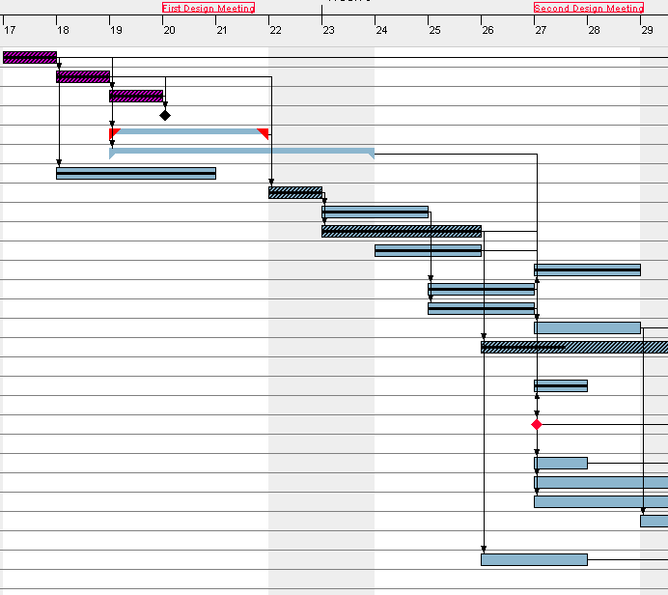
Current Project Status
Slightly behind schedule on Java API
Ahead on schedule with Software Hierarchy
Slightly ahead along critical path
High team morale
Currently well under budget, topic of next slide

Slide 3
Budget
Currently largest different in total hours is 10 hours over the next 4 weeks, definitely cause for reallocation
5 Cases of overtime for the next 4 weeks, represent heavy weeks for certain job titles
  Reallocate if overtime is to be avoided at all costs
  Leave if we are to be understanding that they will have lighter weeks and heavy weeks
Gantt Chart allocation currently has each member working an average of 6.3h/week for the next 4 weeks
Heavily under budget for the first 2 weeks understandable given..
  First Week was approx 3 days long
  Second Week lab 5 was also consuming our time (not registered in budget)

Slide 4
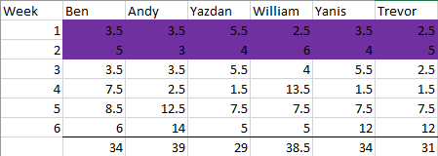
Budget Continued
All hours (not purple) are projections based on Gantt chart and are flexible for change
Also possible I have underestimated hardware lead tasks time needs, especially because my Software Background leads to a misunderstanding of length of hardware tasks
Will either shift around hours or give Yazdan more hours for his current tasks

Slide 5

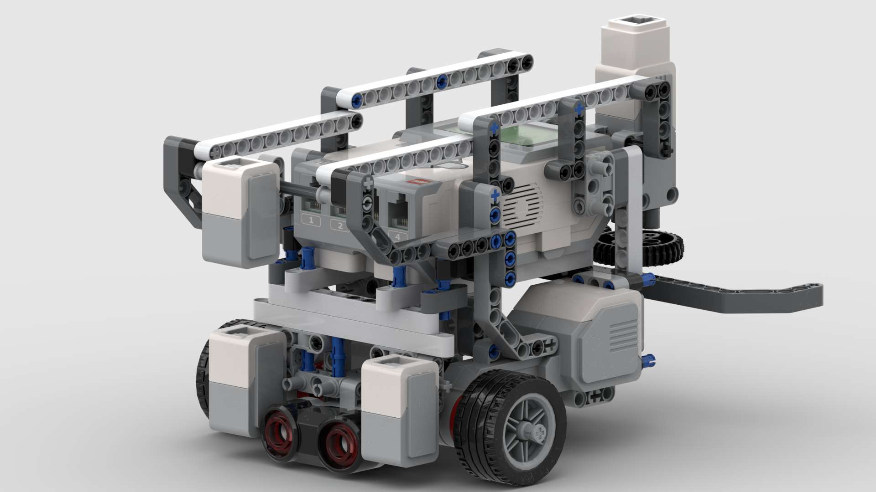
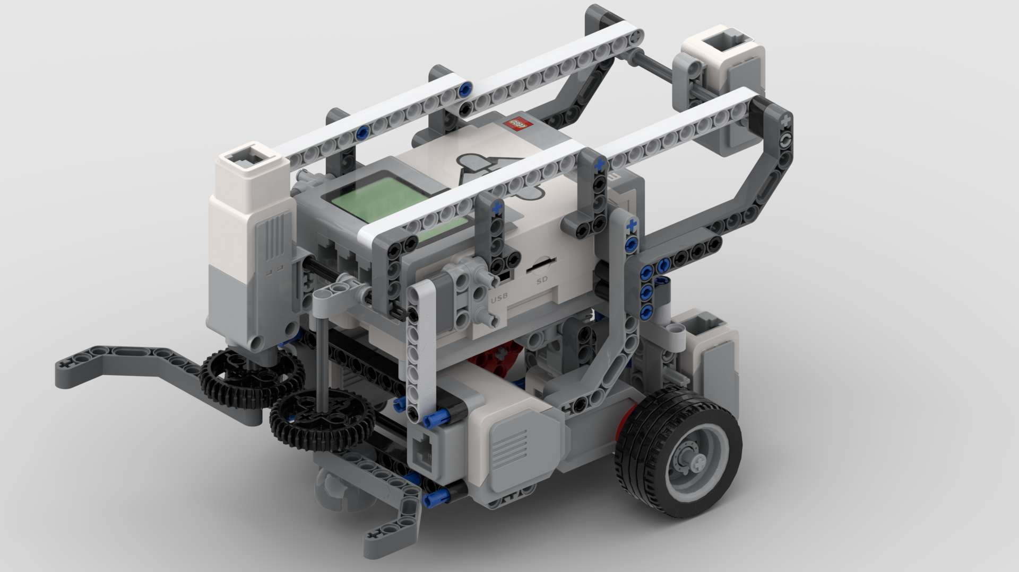
Hardware Design
The robot was designed in bricklink stud.io
LDD/LXF-LDR files were created
A physical model was then built
Objectives met:
Localization
  Both Light and Ultrasonic Localization
Navigation
  Odometer error correction
  Obstacle avoidance
  Size requirements were met
Searching
  Using both Light and Ultrasonic sensor

Slide 6
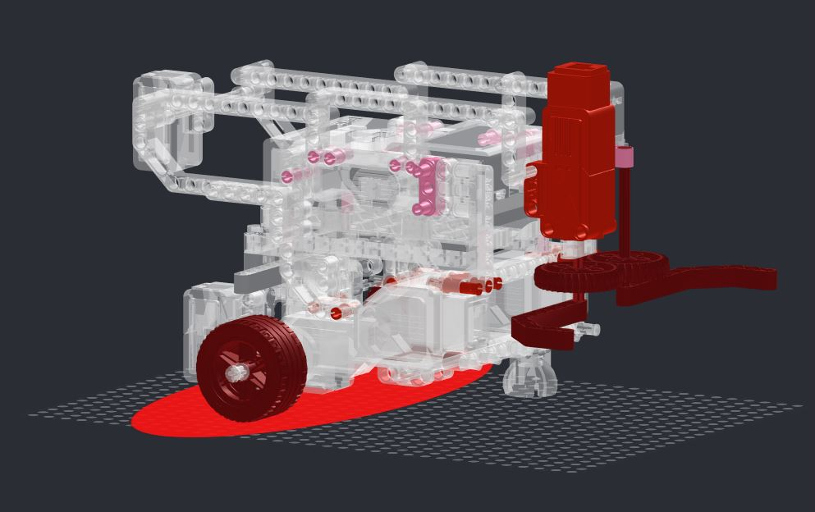
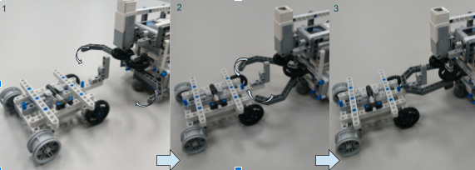
Hardware Design Cont.
Areas to improve
Pickup mechanism
Areas that will be improved during the next week:
Stability of the pickup claw
Battery Accessibility
Weight imbalance in the back of the robot

Slide 7
Hardware Design
The robot was designed in bricklink stud.io
LDD/LXF-LDR files were created
A physical model was then built
Objectives met:
Localization
  Both Light and Ultrasonic Localization
Navigation
  Odometer error correction
  Obstacle avoidance
  Size requirements were met
Searching
  Using both Light and Ultrasonic sensor

Slide 8
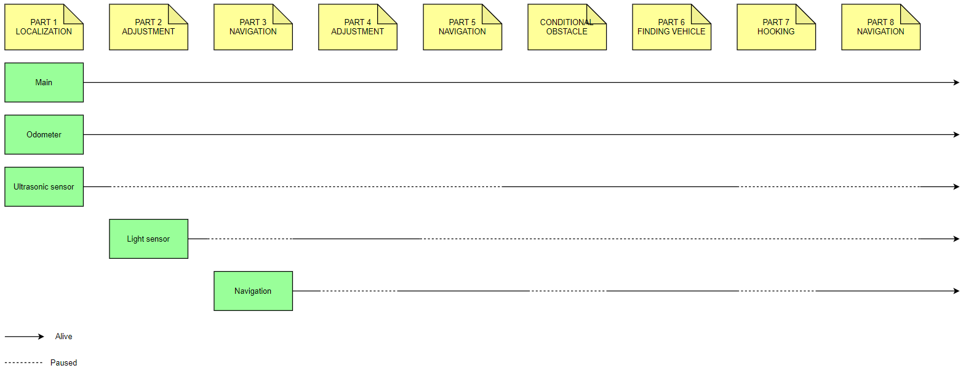
Software Design (more)

Slide 9
Lab 5 and the Project
Time Slot in Gantt Chart on Feb 27th to discuss reusability of Lab 5 for project and lessons learned
1 hour meeting between Project Manager and Software Lead
2 hours allocated in total for this meeting
Precedes “Software Base Builders” task where Software Lead will collect reusable portion of previous lab codes to create a base for project code
  Will also be using class hierarchy as a map for this task

Slide 10
Looking Ahead
Will need to reallocate resources immediately to fix work imbalances
Unit testing, constructing physical model, and software work are big forthcoming events
We are now in the software portion of the critical path, so software activities will be the items to watch
  Software items dominate the critical path
Next meeting with TA, Monday March 9th
Next meeting with Prof. Wednesday March 11th

Slide 11
Questions?

